Slide 1

Engineers & Conflicting Interests
Name:Kowshik Halder
ID:21-45408-3
SECTION: I

Slide 2
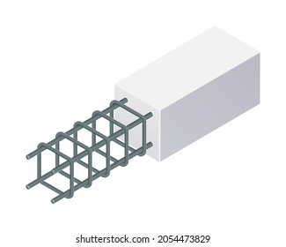


Introduction
Conflicting Interests!

Slide 3

Defining Conflicting Interests
Personal Interest
Professional Duties

Slide 4


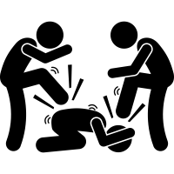
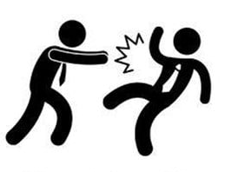
Types of Conflicting Interests
Financial Conflicts
Personal Relationships
External Pressures
Internal Pressures

Slide 5

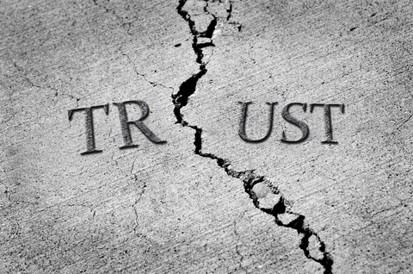

Consequences of Conflicting Interests
Legal and Regulatory Consequences
Loss of trust and credibility
Damaged Professional reputation

Slide 6

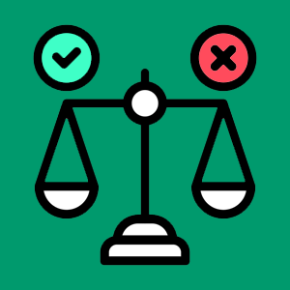


Dealing with Conflicting Interests
Transparency and Open Communication
Ethical Decision-Making Frameworks
Professional Development and Training
Peer Consultation

Slide 7
Conclusion
Types of conflicts
Potential consequences
Proactive strategies to address them

Slide 8

Thank you for your time and attention.
.

